Slide 1
Good morning!!!
We’ll start at 10:00am. Until then, make yourself comfortable!
If you don’t already have a Microsoft Account, get one here: account.microsoft.com
All the exercises will be performed on your own device in a web browser.

Slide 2
Web Development Fundamentals 1
January 2020
Microsoft Reactor | San Francisco
#ReactorSanFrancisco

Slide 3
Presenter’s Name
Title goes here

Slide 4
Workshop Agenda
10:00 am | Introduction to Web Development Keynote
10:30 am | Part 1. Web Basics
11:00 am | Part 2. HTML: Programming the Web
12:00 pm | Lunch + Survey
1:00 pm | Part 3. CSS: Selectors, Styling, and Display
2:30 pm | Capstone Project + Deployment with Azure
3:45 pm | Wrap Up and Next Steps
Notes:
|

Slide 5

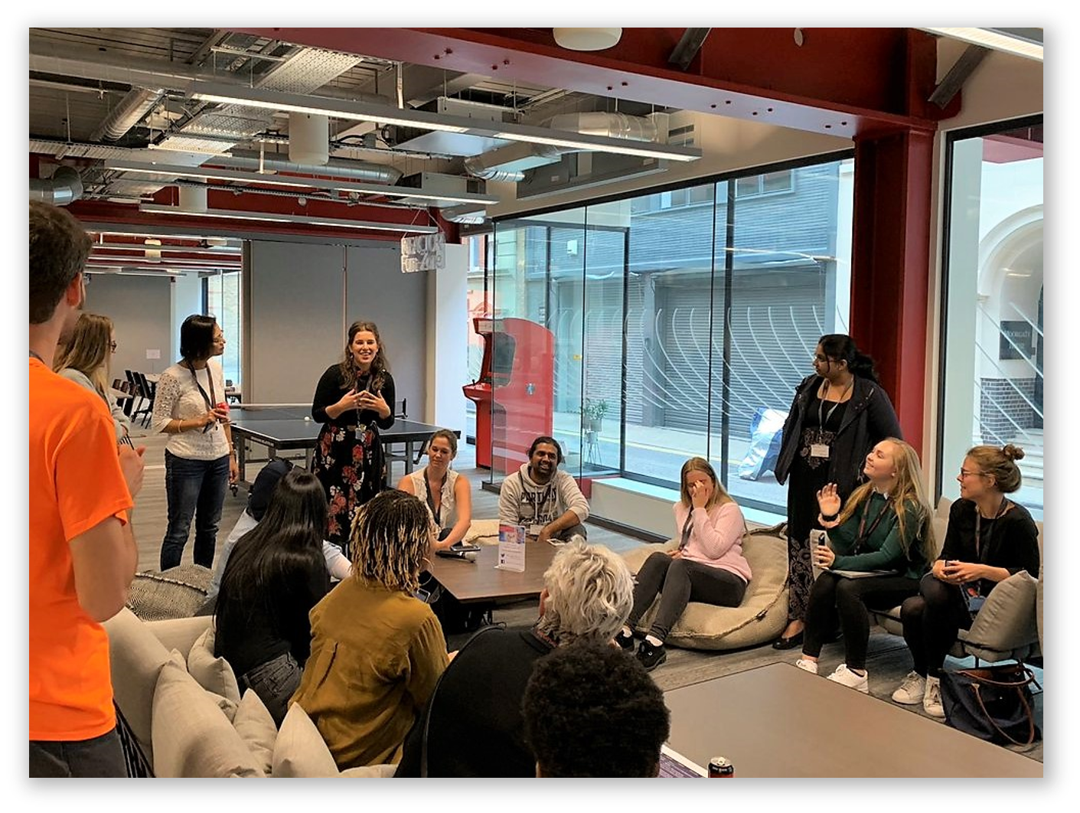


developer.microsoft.com/reactor/
@MSFTReactor on Twitter
Notes:
Welcome to your <location> Microsoft Reactors. We are worldwide local community spaces where developers and startup leaders meet, learn, and connect. Reactors build a diverse community by providing training, learning paths, industry speakers, and seminars, plus meetups and other community events related to emerging technology trends.
Reactor learning, networking, and leadership opportunities are designed to focus on real-world challenges to enable members of the tech community to stay up to date and drive solutions. Reactors are a place to share knowledge and expand impact in the company of technology enthusiasts locally and globally.
We have workshops and other learning opportunities planned throughout the year. Or if you want to host your own event at a Reactor, you can make the request on our website.

Slide 6

Notes on Learning how to Learn
The “Cycle of Learning”
Know why you are learning something.
Work in short highly active and focused periods.
Take a break
Review what just learned before starting something new.
Make connections
Write our experiences to our long-term memory
Concept
Concept
Concept
Your Brain
Notes:
Here’s how we will be working through the workshop today.
1. We will go through each section by starting with why we are learning a specific topic and section, I start by giving a high level overview of the materials we are covering and how this content fits into the big picture.
2. When we work, we work short periods of time with high concentration and intensity. With few distractions.
3. After we’ve finished a section we will take a break.
4. Before we start on new material we will review the material that we just covered.
a. While we are reviewing we need to make connections. We should connect and think about the new concepts we are learning and connect them to old concepts.
b. By making connections and associating data with other data that we are familiar with, we retain the things we learn better.
c. Our brains are giant classification modeling engines.

Slide 7

Web Development Facts: 2020
4,437,215,927 (1/5/2020) Internet Users around the world. (up from 3.42 billion in 2016)
There are 326,474,013 people in the United States, and nearly double that using the internet in China, which has a population of 1,415,045,928.
How many websites are there in 2020? As of January 2020 there were over 1.74 billion websites on the Internet. info.cern.ch was the first-ever website on the Internet, published on August 6, 1991
Approximately 40% of the world’s population had an internet connection in 2018. In 1995, it was less than 1%.
In Asia, China reigns supreme when it comes to having the most active internet users. With 818,934,000 users, the next closest countries include the United States with 320,059,368, Russia with 109,552,842, and Latin America/Caribbean with 18,526,199 users.
Takeaway: The Web is a thriving place, and web developers are needed.
US News and World Reports classify Web Developers as:
#3 Best Technology Jobs
#13 Best STEM Jobs
#23 in best 100 Jobs
Notes:
Web development is the umbrella term for conceptualizing, creating, deploying and operating web applications and APIs (Application Programming Interfaces) for the Web.
The Web has grown a mindboggling amount in the number of sites, users and implementation capabilities since the first website went live in 1991. Web development is the concept that encompasses all the activities involved with websites and web applications.
As a career, web developers are still in high demand, with specializations in web development for mobile apps, data science, and websites emerging weekly.
https://www.websitehostingrating.com/internet-statistics-facts/

Slide 8
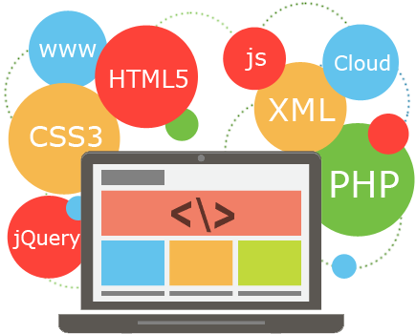
Types of Web Developers
1. Front end developers
2. Back end developers
3. Full stack developer
Notes:
1. Front end developers — one who develops the website and the visuals using HTML, CSS and JavaScript.
2. Back end developers — one who develops the actions on a website or web apps using programming languages like Ruby, Python, Php etc.
3. Full stack developer — one who can develop all layers of the software
Some people also include debuggers and researches in this list.
Developers can also be categorized according to their style of work -
· one who sticks to traditional rules
· one who uses libraries and frameworks
· one with multiple programming language
· one with artistic nature
We also have developers that work in DevOps, MicroServices, and other sub niches of the development industry.

Slide 9



Azure for Web Development
Visual Studio
Visual Studio Code
Unified SDKs
PHP
Go
Java
Python
.NET
Javascript
Cloud Based Tools
Azure Productivity Tools:
Cloud Explorer
Azure Watch
Azure Ping
Cloud Combine
Azure Data Tools
Many more…
Notes:
Microsoft offers a comprehensive set of development tools for any developer—using any platform or language—to deliver cloud applications. Code with the language of your choice using a range of SDKs and take advantage of full-featured integrated development environments (IDEs) and editors with advanced debugging capabilities and built-in Azure support.

Slide 10
The Rise of the Web Developers
Desktop/Laptop computers give us the power to develop web-based applications
Technologies:
Cloud Services
Javascript Engines built into browsers
IP/TCP – Standardized Protocols
Networking Equipment
Fiber Optics
Satellite data transfer
Notes:
Over the past two decades, web development has emerged as a profession due to the fact that we have powerful computers that we can work with at our homes and offices.
The development of supporting technologies have furthered the proliferation of the internet and made the web ubiquitous.

Slide 11
Web Basics

Slide 12
Web Basics Section Overview:
Cornerstone technologies of the Internet
HTTP Request/Response Cycle
Full/Back-end/Front-end Development and Developers

Slide 13
How the internet works:
Clients and Servers
HTTP
IP Addresses
URL
Ethernet
Localhost
Web Hosting
Notes:
Clients and Servers
HTTP
IP Addresses
URL
Ethernet
Localhost
Web Hosting

Slide 14
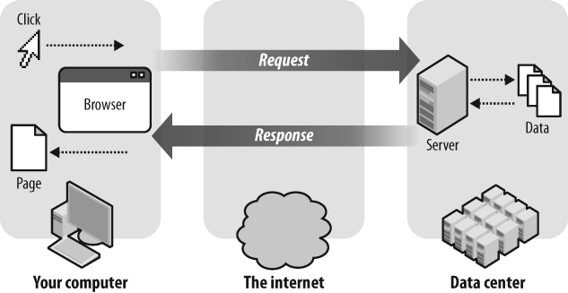
HTTP Request Response Cycle
Notes:
Watch this video and do a similar presentation to talk about the Request/Response Cycle.
https://vimeo.com/107291206
(if asked for a password it’s “codingdojo”)

Slide 15
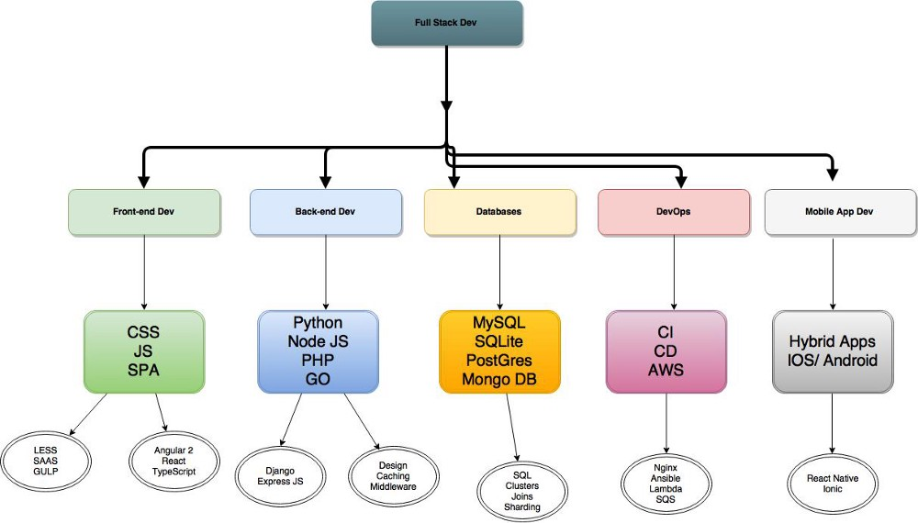
Full Stack Web Development
Notes:
Front end devs:
A front-end developer is a type of computer programmer that codes and creates the visual front-end elements of a software, application or website. He or she creates computing components/features that are directly viewable and accessible by the end user or client. A front-end developer is also known as a client-side developer, HTMLer and front-end coder.
Back end devs:
A back-end developer is a type of programmer who creates the logical back-end and core computational logic of a website, software or information system. The developer creates components and features that are indirectly accessed by a user through a front-end application or system.
Full Stack devs:
Full-stack developers are experts in both the front-end and back-end; so, the full stack of technology that makes up a website. They are proficient in both front-end and back-end languages and frameworks, as well as in server, network and hosting environments. To get to this breadth and depth of knowledge, most full-stack developers will have spent many years working in a variety of different roles. They also tend to be well-versed in both business logic and user experience, meaning they are not only well-equipped to get hands on, but can also guide and consult on strategy too.

Slide 16
Start the Web Basics Section of the Workshop
Start Here: Web Basics
Notes:
Need to link to production

Slide 17
HTML – Hypertext Markup Language

Slide 18
HTML Section Overview
Visual Studio Code
Installing Extensions
HTML Tags and Usage
HTML Tips and Tricks

Slide 19
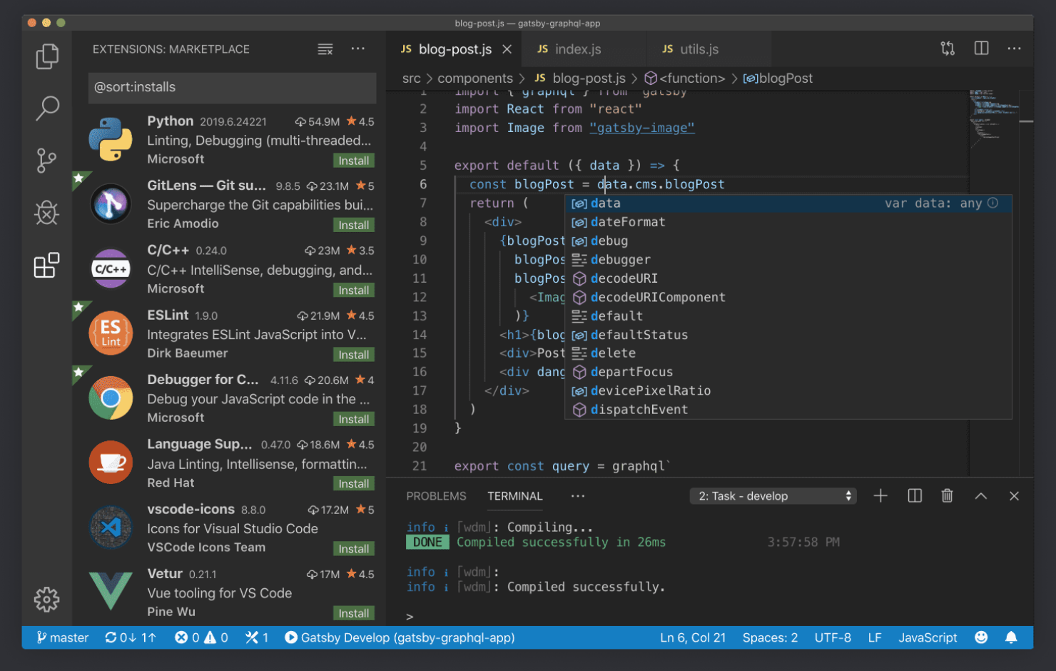
Installing Visual Studio Code
https://code.visualstudio.com
Once you have VSC installed, also install these extensions:
Azure Storage
Azure CLI
HTML Snippets
HTML CSS Support
Notes:
What is the difference between Visual Studio Code and Visual Studio IDE?
Visual Studio Code is a streamlined code editor with support for development operations like debugging, task running, and version control. It aims to provide just the tools a developer needs for a quick code-build-debug cycle and leaves more complex workflows to fuller featured IDEs, such as Visual Studio IDE.
Which OSs are supported?
VS Code runs on macOS, Linux, and Windows. See the Requirements documentation for the supported versions. You can find more platform specific details in the Setup overview.
Is VS Code free?
Yes, VS Code is free for private or commercial use. See the product license for details.

Slide 20
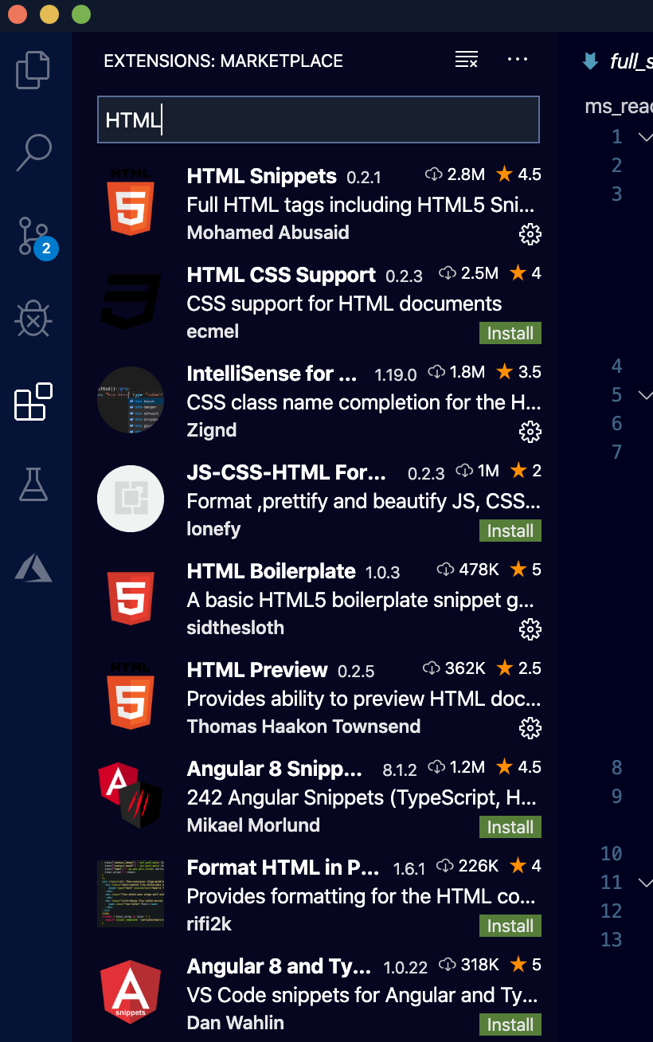
Adding Extensions to Visual Studio Code
2. Enter in the name of the extension here, or just start typing “HTML” or ”Azure” to see what is available.
1. Click here to see the extensions that can be installed.
3. Click the green “install” button to install the extension. Notice that if a ext. has a small gear, it is already installed.
Notes:
VSC has so many extensions it’s hard to know what to install. The good news is that installing and removing extensions is simple and you can try out different exts easily.
Be careful not to install too many at the same time, it could effect the performance of VSC causing lag or even hanging VSC up.
The rule of thumb that I follow is that I only install what I need.
Each extension is used differently, so you should read the documentation for each ext to learn how to use it.

Slide 21
HTML Overview: Basic Template
<!doctype html>
<html lang="en">
<head>
<meta charset="utf-8">
<title>The HTML5 Herald</title>
<meta name="description" content=”Your first HTML Page">
<meta name="author" content="SitePoint">
<link rel="stylesheet" href="css/styles.css?v=1.0">
</head>
<body>
<script src="js/scripts.js"></script>
</body>
</html>
Semantic HTML:
<header>
<section>
<form>
Non-Semantic HTML:
<img>
<div>
<p>
<span>
<input>
Notes:
*** Demo: Open up VSC and create a simple webpage from tags and discuss the tags as you build the page:
Go over HTML tags
Head * location in the HTML file where you can define attributes for a page
Title * Appears as the name of the webpage in the browser
Meta * various information that describes a webpage
Link * Linking other files like css and JS
Body * where the content of a webpage is held
Html * classifies the whole page
Discuss Sematic HTML: Semantic means, “meaning” or to give meaning.
A semantic element clearly describes its meaning to both the browser and the developer.
Examples of non-semantic elements: <div> and <span> - Tells nothing about its content.
Examples of semantic elements: <form>, <table>, and <article> - Clearly defines its content.
Fun fact and ?:
** HTML is recursive, why is it recursive?
** Who invented HTML? (Scientists at CERN Europe, who used it to classify and report their findings)

Slide 22
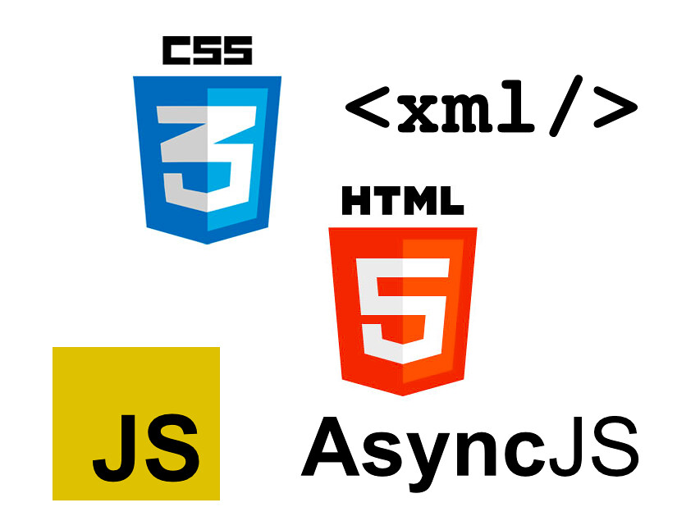
HTML Tips
Use Proper Document Structure
Constantly Validate Your Code!
Organize HTML Syntax
Avoid Using Too Many divs!
Make Use of Semantic Elements
Keep Your Tag Names Lowercase
Use alt Attribute With Images
Notes:
HTML is a language that allows poor code to execute and render to varying levels of accuracy. Successful rendering, however, does not mean that our code is correct or guarantee that it will validate as standards compliant. Poor code is unpredictable, and you can't be certain what you're going to get when it renders. We have to pay close attention when writing HTML and be sure to nest/indent and close all elements correctly and to always validate our code.
Use Proper Document Structure
Pages will render without the use of the <!DOCTYPE html> doctype or <html>, <head>, and <body> elements. However, without the doctype and these structural elements, pages will not render properly in every browser.
Constantly Validate Your Code!
While writing HTML, make a habit to validate frequently; this will save you from issues that are harder to pinpoint (or redo) once your work is completed and lengthier.
HTML validation services such as the free W3C Markup Validation Service are useful debuggers that help you identify rendering errors.
Organize HTML Syntax
As your HTML gets bigger, managing it can become quite a task. Below are quick rules that can help you keep your syntax clean and organized:
Use lowercase letters within element names, attributes, and values.
Indent nested elements.
Use double quotes, not single or completely omitted quotes to store in values for HTML attributes.
Avoid Using Too Many divs!
When writing HTML, it is easy to get carried away adding <div> elements here and there to build out necessary styles. While this works, it can add quite a bit of bloat to a page, and before too long we're not sure what each <div> element does.
Make Use of Semantic Elements
Deciding which elements to use to describe different content may be difficult, but these elements are the backbone of semantics.
Note: Semantic HTML is the use of HTML markup to reinforce the semantics, or meaning, of the information in webpages rather than merely to define its presentation or look. via: en.wikipedia.org/wiki/Semantic_HTML Here the HTML doesn't use the proper heading and paragraph elements; instead, it uses meaningless elements to group content.
Keep Your Tag Names Lowercase
Technically, you can get away with capitalizing your tag names. Having said that, the best pra ctice is to keep all tags lowercase.
Use alt Attribute With Images (Not adding Alt tags is like discriminating a whole group of people who use screen readers)
Using meaningful alt attributes with <img> elements is a must for writing valid and semantic code. The alt information is helpful for when a user cannot view your image - whether due to a connection issue, a missing image, or because the user is utilizing a screen reader.

Slide 23
CSS – Cascading Style Sheets

Slide 24
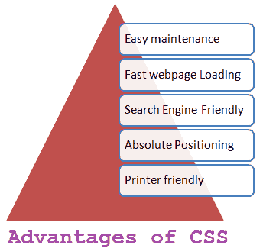
CSS Section Overview
CSS Selectors: id, class, tag
Styling Elements and Text
Using the Inspect Tool
Display Property and Box Model
Plotting Your Blocks

Slide 25
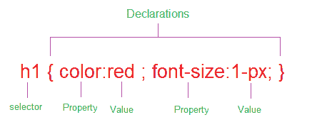
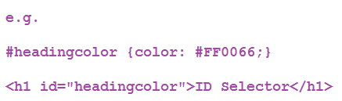
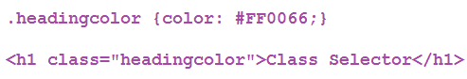
CSS Selectors
Selecting by #, . , <tag> (what’s the difference?)
Adding CSS to your webpages
CSS Priority/Specificity
CSS Resets/Libraries
Responsive?
Selecting by id and class
Notes:
*** Demo: Open VSC and connect the HTML page you created in the HTML section to a CSS file.
Discuss how to select HTML elements with class, id and tag.
ID selectors, Class selectors
The role of a selector is to tell the browser to which style is applied to a specific element in an HTML document. Selectors are patterns used to select the HTML tags that you want to style. These patterns may range from simple element names to rich contextual patterns.
ID selector
ID selectors in CSS allow you to target elements (Tags) by their ID values. ID selectors are unique, so you can apply only to the content of one element. To reference an ID, you precede the ID name with a hash mark (#).
Class selector
The Class selector in CSS , which references the class attribute used on HTML elements. The Class selector begins with a dot(.) and followed by a class name which you choose.
Explain CSS priority, it should be one of the first things you think about if you can’t “grab” an element and style it.

Slide 26
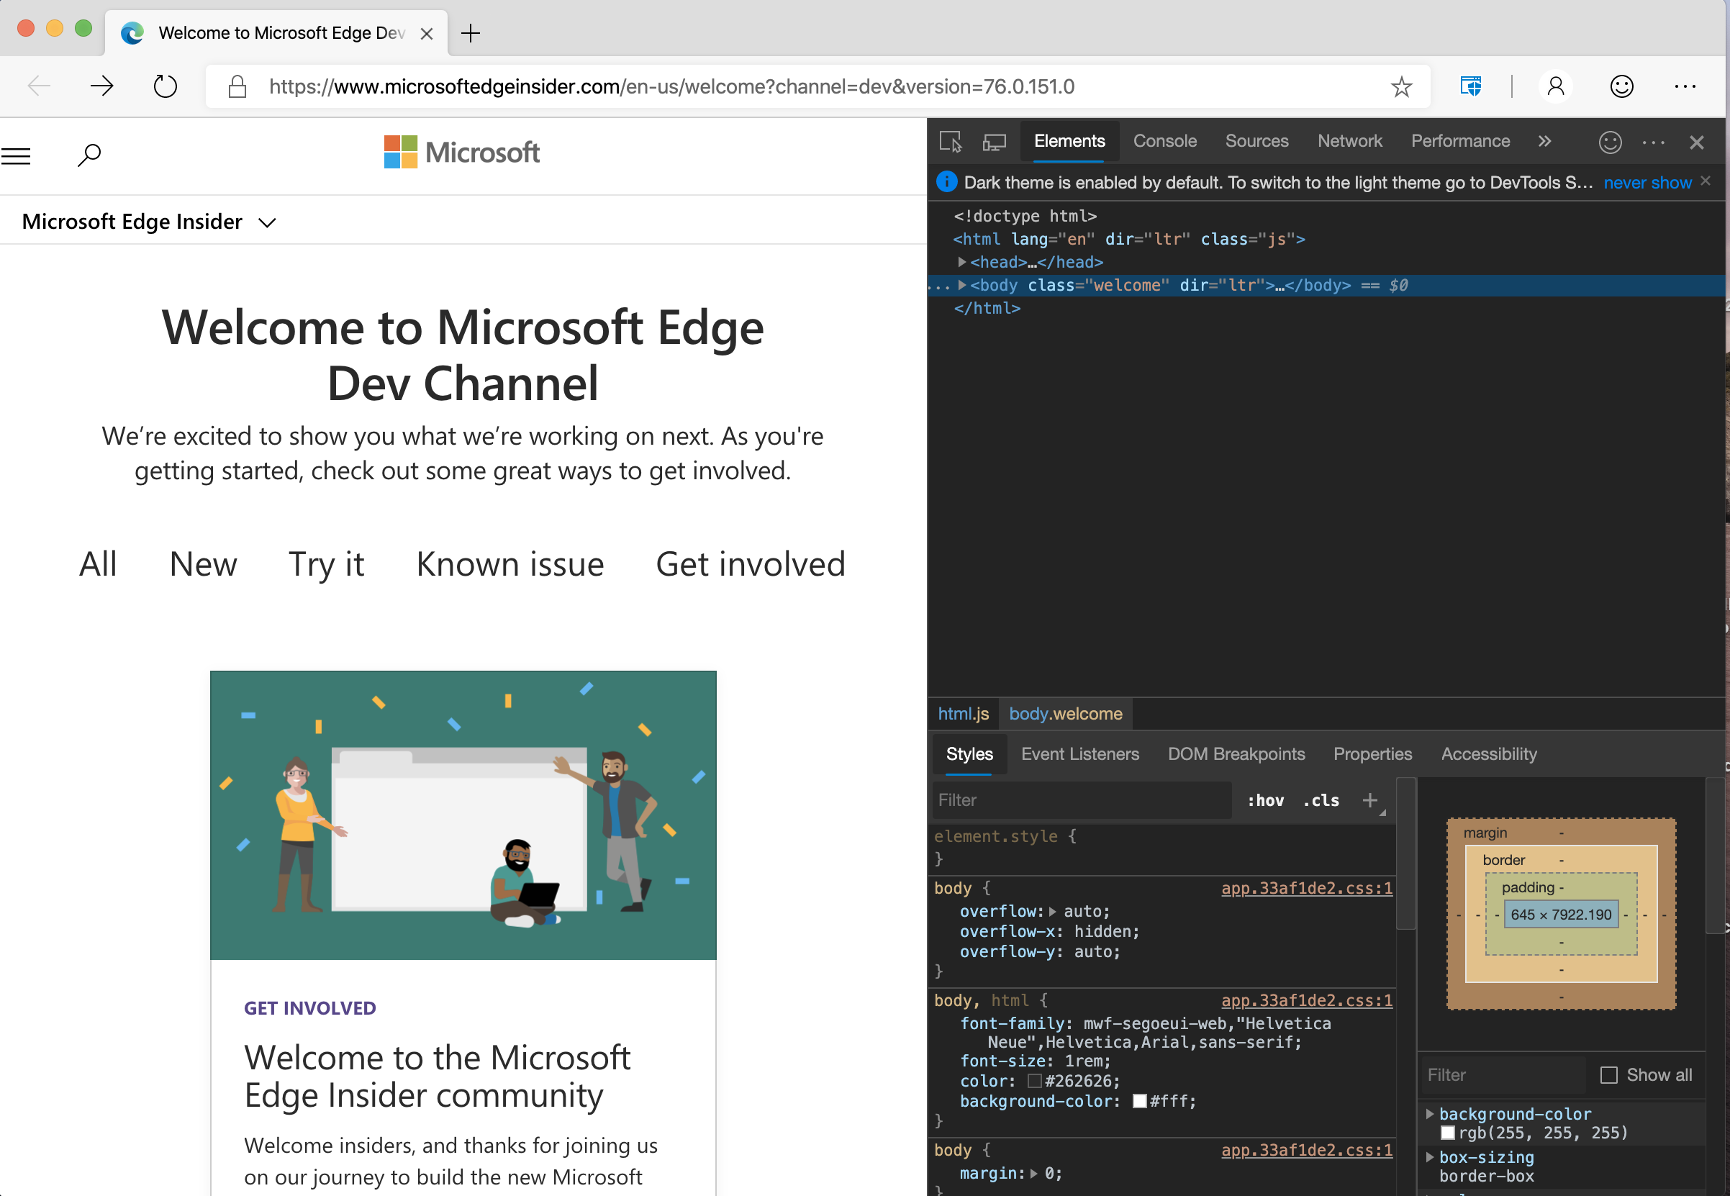
Using The Inspect Element Tool
Select individual elements
You can run JavaScript code in the console here.
Notes:
Explain how to access the Inspect tool: Here’s a resource for all the major browsers: https://www.lifewire.com/get-inspect-element-tool-for-browser-756549
Highlight the Console, and the specific element selection button.
Explain how you can change CSS here and “test” out how things will look, also getting sizes of elements is useful here.

Slide 27
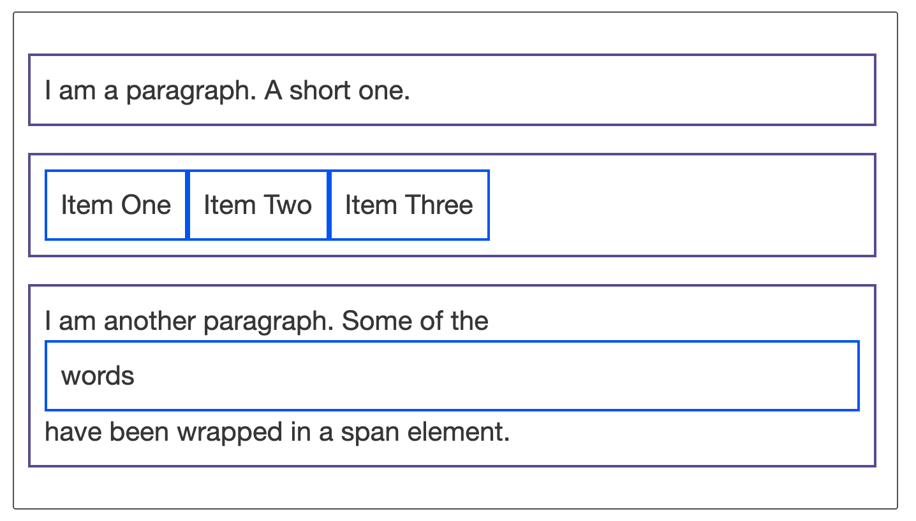
The Display Property
The display property specifies the display behavior (the type of rendering box) of an element.
Inline
Block
Flex
Grid
Click here to play with the code.
Notes:
In HTML, the default display property value is taken from the HTML specifications or from the browser/user default style sheet
Inline
Displays an element as an inline element (like <span>). Any height and width properties will have no effect
Block
Displays an element as a block element (like <p>). It starts on a new line, and takes up the whole width
Contents
Makes the container disappear, making the child elements children of the element the next level up in the DOM
Flex
Displays an element as a block-level flex container
Grid
Displays an element as a block-level grid container
Let's move on and have a look at some examples. Below we have three different HTML elements, all of which have an outer display type of block. The first is a paragraph, which has a border added in CSS. The browser renders this as a block box, so the paragraph begins on a new line, and expands to the full width available to it.
The second is a list, which is laid out using display: flex. This establishes flex layout for the items inside the container, however, the list itself is a block box and — like the paragraph — expands to the full container width and breaks onto a new line.
Below this, we have a block-level paragraph, inside which are two <span> elements. These elements would normally be inline, however, one of the elements has a class of block, and we have set it to display: block.
Open this pen and go over the code for the image above: https://codepen.io/dannyooooo/pen/Powybqr

Slide 28
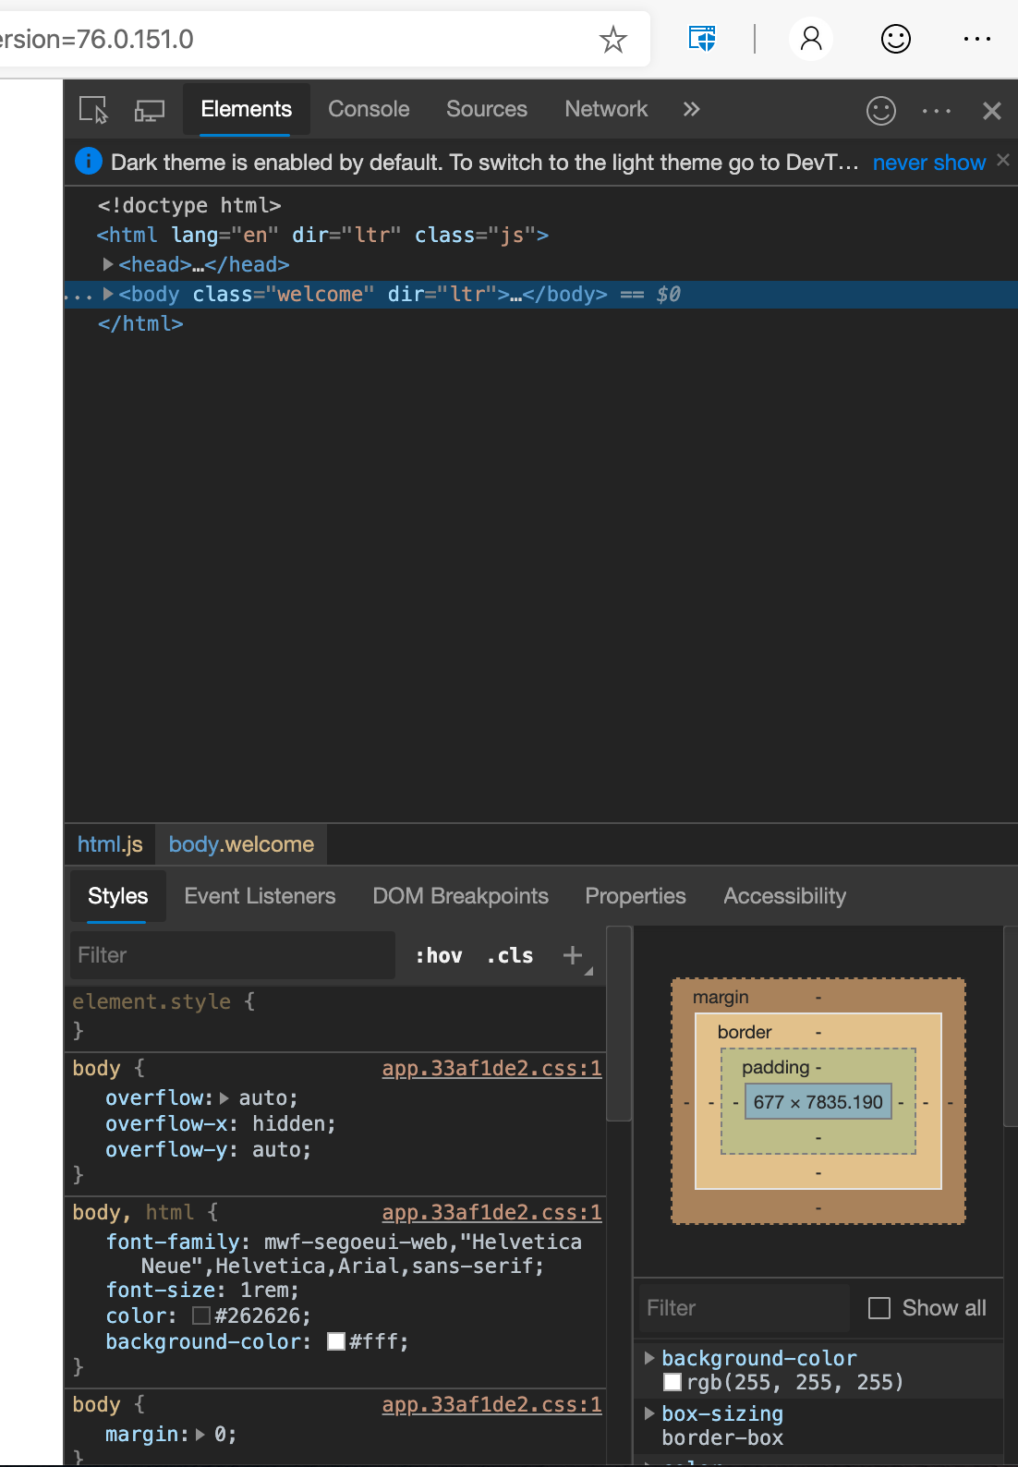
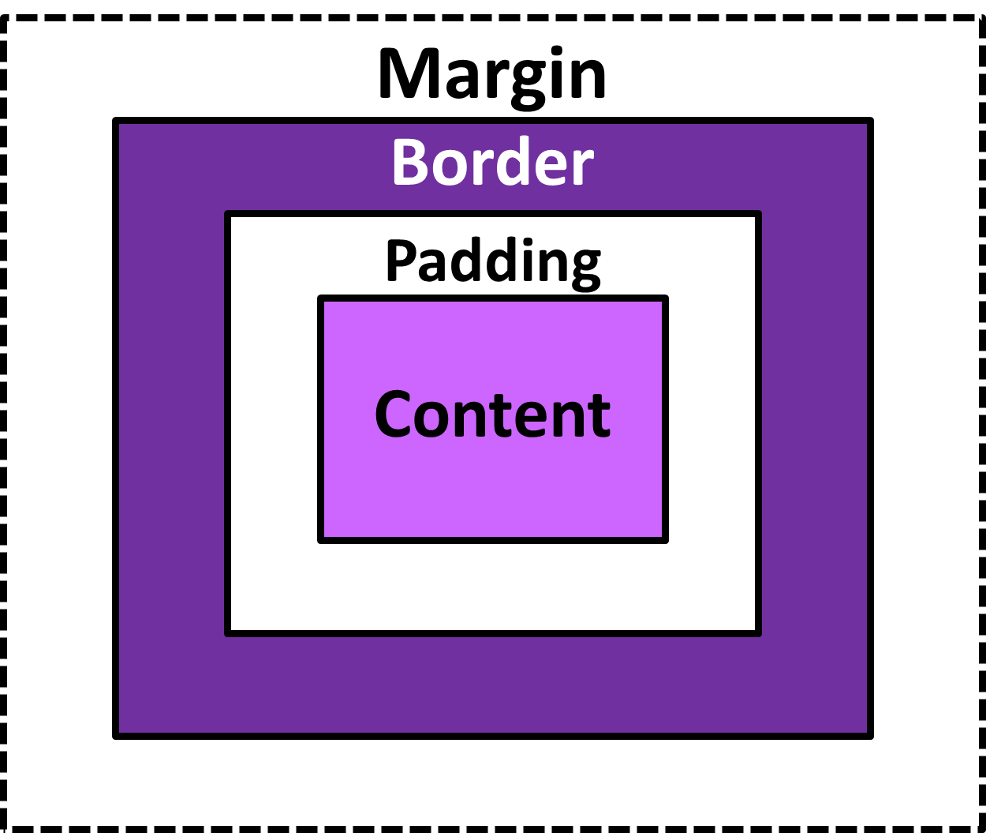
Box Model
Box Model
In Inspect Element
Notes:
Great resource for the box model: https://learn.shayhowe.com/html-css/opening-the-box-model/
*** Demo Open this activity and play with code: https://codepen.io/dannyooooo/pen/zYxmoBP
Play with margins and padding.
Explain how to adjust in Inspect Element tool.
Ask about the differences
Show the code with and without “outline: 1px solid green” and explain why outline is useful as a way to see all your elements and how they are overlapping or not.
CSS Outline
An outline is a line that is drawn just outside the border edge of the elements such as buttons, active form fields, etc., to make them stand out.
Outlines Vs Borders
The outlines are generally used to highlight elements. An outline at a glance looks very similar to the border, but it differs from border in the following ways:
Outlines do not take up space, because they always placed on top of the box of the element which may cause them to overlap other elements on the page.
Unlike borders, outlines won't allow us to set each edge to a different width, or set different colors and styles for each edge. An outline is the same on all sides.
Outlines don't have any impact on surrounding elements apart from overlapping.
Unlike borders, outlines don't change the size or position of the element.
Outlines may be non-rectangular.

Slide 29
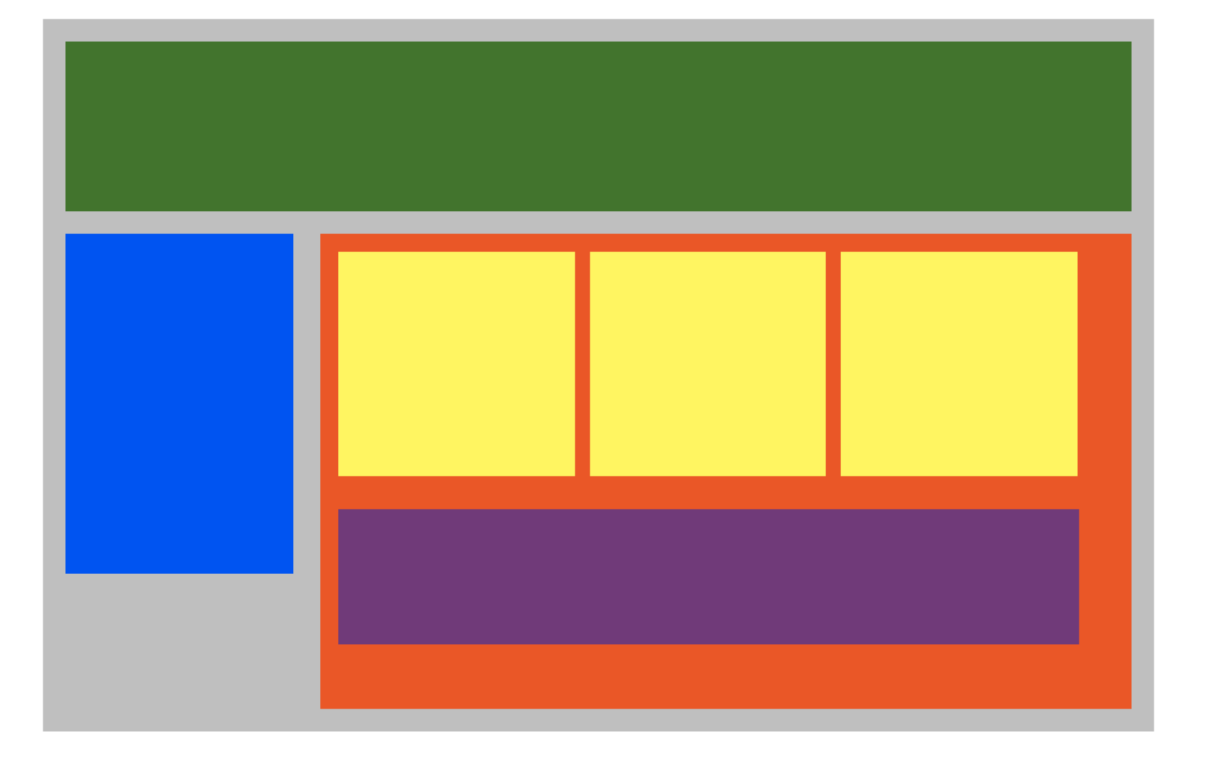
Plotting Your Blocks
Notes:
*** Demo Open this pen and go through the code. You’ll do this after the students have already attempted this. Don’t let them go longer than 30-40 minutes before walking them through this.
Student’s version:
https://codepen.io/dannyooooo/pen/100311ce217467fbcf13862a5090012b
Solution:
https://codepen.io/dannyooooo/pen/Powybmo
Explain how this can be done with just margin and padding adjustments.

Slide 30
Please take a moment to complete this survey. Survey: https://aka.ms/ReactorFeedback

Slide 31
Capstone project

Slide 32
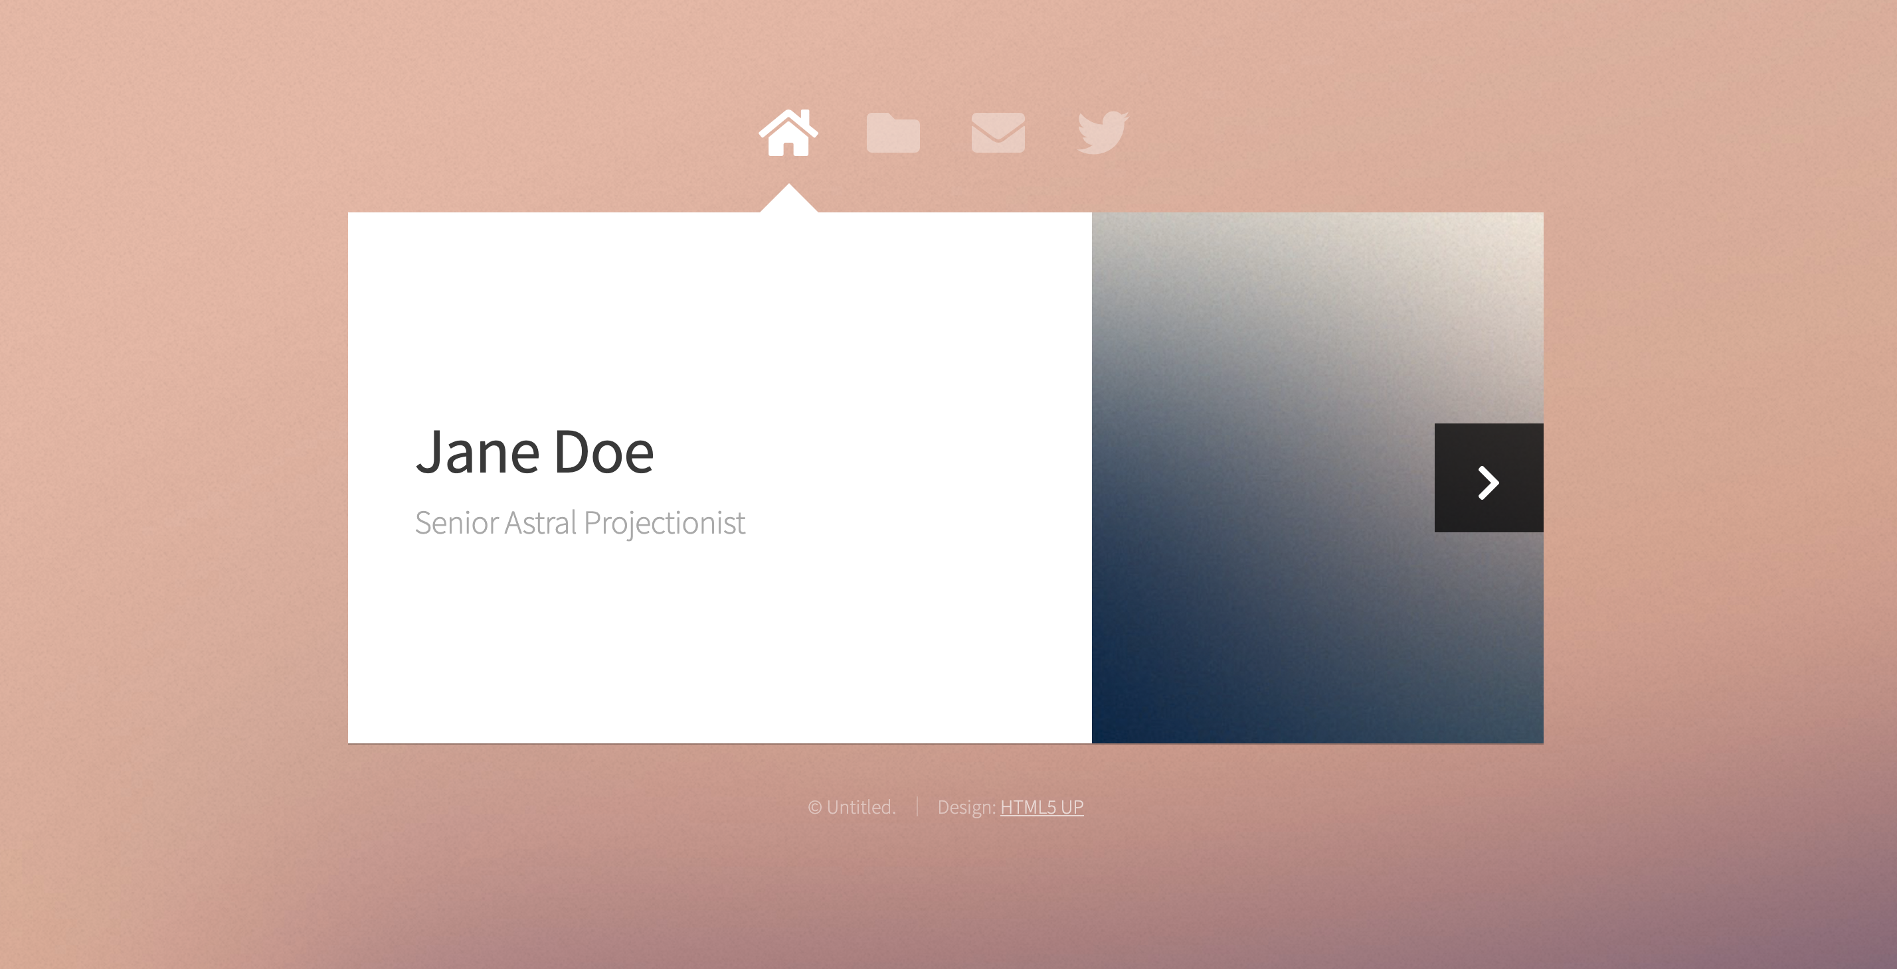
Capstone Project
Notes:
Show students live site : https://cs28156a2b80b43x4d02x8a8.z13.web.core.windows.net/
Demonstrate how they can edit the site
You should download the code in the “portfolio-1” folder and deploy to a storage container on Azure Storage
Then make changes to the code and then go through the update process
Demonstrate how to Deploy using Azure Storage.
Follow the steps in the deploy.md file

Slide 33
Share your portfolio sites! Questions?
Notes:
Over the past two decades, web development has emerged as a profession due to the fact that we have powerful computers that we can work with at our homes and offices.
The development of supporting technologies have furthered the proliferation of the internet and made the web ubiquitous.

Slide 34
Additional Learning Resources and Next Steps

Slide 35
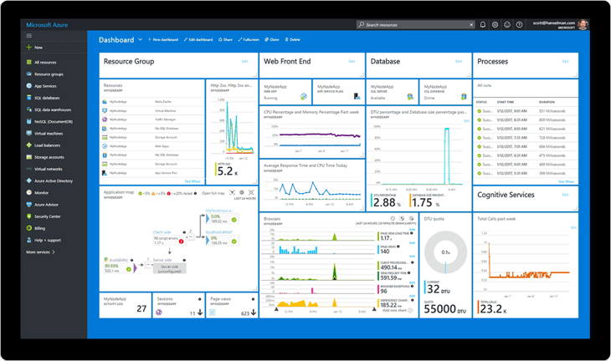
Free Azure for your next experiment…
azure.microsoft.com/free/
azure.microsoft.com/free/students/
Notes:
https://azure.microsoft.com/free/
Pros: $200 for 30 days + Always Free Tier
https://azure.microsoft.com/free/students/
Students: $100 for 12 months + Always Free Tier

Slide 36
Further Learning in Web Development on Azure…
Microsoft Learn has free learning in a cloud sandbox:
Azure Fundamentals - https://docs.microsoft.com/en-us/learn/paths/azure-fundamentals/
Deploy a Website with Azure Virtual Machines - https://docs.microsoft.com/en-us/learn/paths/deploy-a-website-with-azure-virtual-machines/)
C#: First Steps - https://docs.microsoft.com/en-us/learn/paths/csharp-first-steps/
Deploy a website with Azure App Service - https://docs.microsoft.com/en-us/learn/paths/deploy-a-website-with-azure-app-service/
/

Slide 37

Role-based Microsoft certs for development:
Microsoft Certified Solutions Associate
Microsoft Certified Solutions Developer (MCSD)
Microsoft Certified: Azure Developer Associate
Azure Fundamentals

Slide 38
developer.microsoft.com/reactor/
@MSFTReactor on Twitter
Notes:
Thank you!

Slide 39
© 2019 Microsoft Corporation. All rights reserved. The text in this document is available under the Creative Commons Attribution 3.0 License, additional terms may apply. All other content contained in this document (including, without limitation, trademarks, logos, images, etc.) are not included within the Creative Commons license grant. This document does not provide you with any legal rights to any intellectual property in any Microsoft product. You may copy and use this document for your internal, reference purposes.
This document is provided "as-is." Information and views expressed in this document, including URL and other Internet Web site references, may change without notice. You bear the risk of using it. Some examples are for illustration only and are fictitious. No real association is intended or inferred. Microsoft makes no warranties, express or implied, with respect to the information provided here.

Slide 40
Capstone project

